Slide 1


Parallel Bubble Sort
Pid: 13 Guide: Prof. J. R. Mankar
Team members:
Sanket Sutar (49)
Prathamesh Chaudhari (50)
Piyush Patil(51)
Rupesh Deshmukh (52)

Slide 2
Introduction
The sequential version of the bubble sort algorithm is considered to be the most inefficient sorting method in common usage.
Sequential bubble sort algorithm is very easy to implement.
Parallel sorting algorithms arranges a set of elements using multiple processors in order to enhance the performance of sequential sorting algorithms.

Slide 3
Objective:
To implement parallel bubble sort by using OpenMp.
To compare parallel bubble sort with sequential bubble sort.

Slide 4
OpenMP
OpenMP uses a portable, scalable model that gives programmers a simple and flexible interface for developing parallel applications for platforms ranging from the standard desktop computer to the supercomputer.
OpenMP is very widely used API for parallel programing.
The API is specified for C/C++ and Fortran.

Slide 5
Time Complexity
Best case Time Complexity : O(n)
Worst and Average Case Time Complexity: O(n*n)
Space Complexity : O(1)

Slide 6
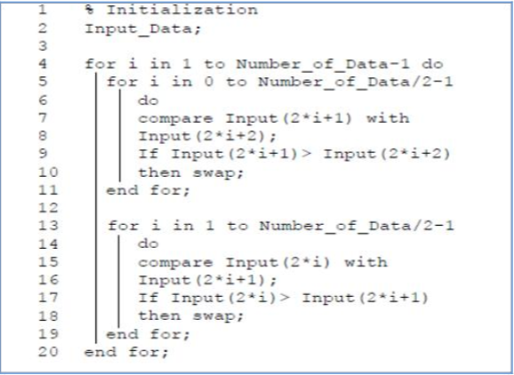
Parallel Bubble Sort Algorithm

Slide 7
x-axis: number of elements sorted.
y-axis: time in seconds

Slide 8
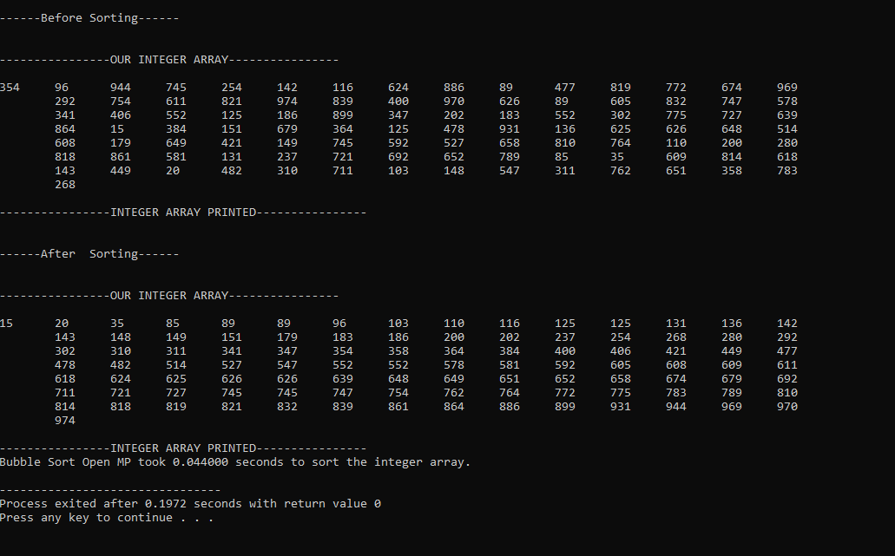
Screenshot of Output

Slide 9
Conclusion
Hence we have successfully implemented parallel bubble sort by using OpenMP.

Slide 10
Thank you…..

